Slide 2
Introduction to XSL
In this first lesson, Introduction to XSL, you will learn to:
  Define XSL, XSLT, and their purpose.
  Explain the structure and syntax of XSL.
  Distinguish between CSS and XSL.
2

Slide 3
Style Sheets 1-2
A style sheet is a collection of commands that tells a processor (such as a Web browser, or a document reader) how to render the visual appearance of content in a Web page.
Style sheets typically contain instructions such as:
  Number figures sequentially throughout the document.
  Display hypertext links in blue.
  Position text and images on a Web page.
  Create a layout optimized for small displays for mobile phones.
  Cascading Style Sheet (CSS) is a style sheet technology that is used for HTML content formatting.

Slide 4
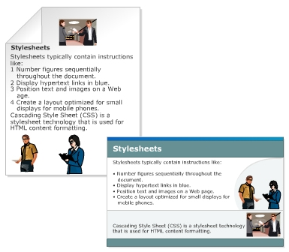
Style Sheets 2-2
Figure shows an example where a style sheet is applied.

Slide 5
Extensible Style Sheet Language (XSL) 1-4
Extensible Style Sheet Language (XSL) is developed by World Wide Web Consortium (W3C) to describe how the XML document should be displayed.
XML
XSL
XSL Processor
HTML

Slide 6
Extensible Style Sheet Language (XSL) 2-4
Is an XML-based language used to create style sheets.
Is designed to format XML content for display purposes and also has the ability to completely transform XML documents.
Is a specification from the World Wide Web Consortium (W3C).
XSL Transformation Recommendation describes the process of transforming an XML document, using a transformation engine and XSL.
The XML document and XSL style sheet are provided as input to the XML transformation engine, also known as the XSLT processor.
The output of the processor is in the form of a result tree in which the elements of the XML document are converted into nodes having specific text values and attributes. XSLT processors use XSL style sheets to gather instructions for transforming source XML documents to output XML documents. Style sheets are used to change the structure of the XML document and modify the output.

Slide 7
Extensible Style Sheet Language (XSL) 3-4
XSL consists of three languages:
  XSL Transformations (XSLT)
    XSLT transforms an XML document into another XML document that can actually be understood and displayed by a computer.
  XML Path Language (XPath)
    XPath is used as the navigator for XSL. XSL uses XPath to find parts of the source document that should match a certain predefined template. When XPath finds the node, XSLT takes over and performs a transformation, turning the source document into a result document.
  XSL Formatting Objects (XSL-FO)
    An XML language for formatting XML documents. Once XPath has searched through the source document and used XSLT to transform the source document into the result document, the document then needs to be formatted so that the Web browser will be able to present the document with the proper layout and structure. Simply put, XSL-FO is the part of XSL that produces the final output.

Slide 8
Extensible Style Sheet Language (XSL) 4-4
Figure depicts the structure of XSL.
XSL
XSLT
XPath
XSL-FO

Slide 9
XSL Transformations
The transformation component of the XSL style sheet technology is XSLT.
Its purpose is to transform XML documents.
It describes the process of transforming an XML document, using a transformation engine and XSL.
The XML document and XSL style sheet are provided as input to the XML transformation engine, also known as the XSLT processor.
The output of the processor is in the form of a result tree in which the elements of the XML document are converted into nodes having specific text values and attributes.

Slide 10
XSL Processing Model 1-2
The XML processor reads an XML document and processes it into a hierarchical tree containing nodes for each piece of information in a document. After a document has been processed into a tree, the XSL processor begins applying the rules of an XSL style sheet to the document tree.
The XSL processor starts with the root node in the tree and performs pattern matching in the style sheet.
These patterns are stored within constructs known as templates in XSL style sheets.
The XSL processor analyzes templates and the patterns associated with them to process different parts of the document tree.
When a match is made, the portion of the tree that matches the given pattern is processed by the appropriate style sheet template.
At this point, the rules of the template are applied to the content to generate a result tree. The result tree is itself a tree of data and the data has been transformed by the style sheet.

Slide 11
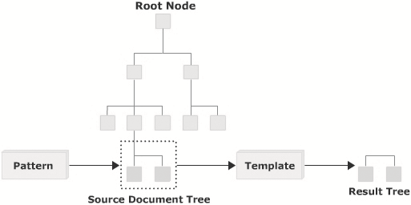
XSL Processing Model 2-2
Figure displays the XSL processing model.

Slide 12
XSLT Structure and Syntax 1-2
XSLT follows normal rules of XML syntax. It uses a standard document introduction, matching closing tags for any opening tags that contain content, and a proper syntax for empty elements.
In XSL, the style rules are written in a file with the extension .xsl. This file is associated with an XML document by using the statement <?xml-stylesheet href="xsl file" type="text/xsl"?>. Here, the xml-stylesheet is the processing instruction.
All XSLT style sheets use the xsl:stylesheet element as the document element.

Slide 13
XSLT Structure and Syntax 2-2
An XSLT document takes the following basic form:
where,
  <xsl:stylesheet>: Root element of the style sheet.
  xmlns:xsl="http://www.w3.org/1999/XSL/Transform": Refers to the official W3C XSLT namespace. You must include the attribute version="1.0" if you use this namespace.
  The XSLT namespace must be declared at the top of the document in order to get access to the XSLT elements, attributes, and features.
Syntax
<xsl:stylesheet version="1.0"
xmlns:xsl="http://www.w3.org/1999/XSL/Transform">
………
………
</xsl:stylesheet>

Slide 14
Top Level XSLT Elements
The top level XSLT elements can occur directly inside the xsl:stylesheet element.
An element occurring as a child of an xsl:stylesheet element is called a top-level element.
These elements provide the building blocks for creating XSLT documents.
The top level elements in the XSLT syntax are listed in the following table.
These elements can occur directly inside the xsl:stylesheet or xsl:transform elements.
Element | Description
xsl:decimal-format | Defines the default decimal format for number to text conversion.
xsl:include | Used to include one stylesheet into another.
xsl:key | Defines a named key to be used with the key() function for operating on patterns and expressions.
xsl:output | Defines the format of the output created by the stylesheet.
xsl:preserve-space | Defines the elements for which white space should be preserved.

Slide 15
xsl:decimal-format XSLT Element 1-2
Syntax
<xsl:decimal-format decimal-separator=”character” digit=”character” grouping-separator=”character” infinity=”string” minus-sign=”character” name=”name” NaN=”string” pattern-separator=”character” percent=”character” per-mille=”character” zero-digit=”character”/>
where,
  decimal-separator=”character”: Defines the character that is used to separate the integer and fraction part of a number. The default is a dot (.).
  digit=”character”: Defines the character that is used to signify that a digit is needed in a format pattern. The hash (#) is the default.
  grouping-separator=”character”: Defines the character that is used to separate groups of digits. The default is a comma (,).
  infinity=”string”: Defines the string that is used to represent the infinite value. The default is the string, ‘infinity’.
  minus-sign=”character”: Defines the character that is used to represent a minus sign. The default is the hyphen (-).
  name=”name”: Assigns a name to the element.
  NaN=”string”: Defines the string that is used to indicate that the value is not a number. The default is string, ‘NaN’.
  pattern-separator=”character”: Defines the character that is used to separate positive and negative sub patterns in a format pattern. The default is semicolon (;).
  percent=”character”: Defines the character that is used to represent a percent sign. The default is the percent sign (%).
  per-mille=”character”: Defines the character that is used to represent the per thousand sign. The default is the Unicode per mille character (%).
  zero-digit=”character”: Defines the character that is used to represent the digit zero. The default is (0).

Slide 16
xsl:decimal-format XSLT Element 2-2
The code demonstrates the several numeric format variations.
The select statement returns the values 45665789.000, 35%, 789.0, $123,456,789, 96.5%, NaN, and Infinity respectively.
Snippet
<xsl:stylesheet xmlns:xsl="http://www.w3.org/1999/XSL/Transform" version="1.0">
<xsl:decimal-format name="name" digit="D" />
<xsl:output method="html"/>
<xsl:template match="/">
<xsl:value-of select='format-number(45665789, "#.000")' />
<xsl:value-of select='format-number(0.3456789, "###%")' />
<xsl:value-of select='format-number(789, "D.0", "name")' />
<xsl:value-of select='format-number(123456789, "$DDD,DDD,DDD.DD","name")' />
<xsl:value-of select="format-number(193 div 200, '###.#%')"/>
<xsl:value-of select="format-number(a div 0, '###,###.00')"/>
<xsl:value-of select="format-number(1 div 0, '###,###.00')"/>
</xsl:template>
</xsl:stylesheet>

Slide 17
xsl:include XSLT Element
Syntax
where,
  href = "uri": A Uniform Resource Identifier address identifying the XSLT file to be included.
  The following code demonstrates how to include another style sheet file within a style sheet file.
<xsl:include href = "uri"/>
Snippet
<xsl:stylesheet xmlns:xsl="http://www.w3.org/1999/XSL/Transform" version="1.0">
<xsl:include href="ExampleTemplate.xsl"/>
<xsl:template match="/">
...........
..........
</xsl:template>
</xsl:stylesheet>

Slide 18
xsl:key XSLT Element 1-2
Syntax
where,
  match="pattern": Defines the nodes to which the key will be applied.
  name="qname": Specifies the qualified names of the key.
  use="expression": Used to determine the value of the key for each node.
<xsl:key match="pattern" name="qname" use="expression"> </xsl:key>
The following code contains the XML file and demonstrates how to use the xsl:key element.
Snippet
<?xml version="1.0" encoding = "UTF-8"?>
<?xml-stylesheet type="text/xsl" href="key.xsl"?>
<APTstaff>
<Developer name="David Blake" address="B-602, East West Coast" phone="567-877-9766"/>
<Developer name="Roger Blake" address="B-345, East West Coast" phone="345-865-9777"/>
</APTstaff>

Slide 19
xsl:key XSLT Element 2-2
The following code contains the style sheet file and demonstrates how to use the xsl:key element.
Output:
  NAME: David Blake ADDRESS: B-602, East West Coast PHONE: 567-877-9766
Snippet
<xsl:stylesheet xmlns:xsl="http://www.w3.org/1999/XSL/Transform" version="1.0">
<xsl:key name="stafflist" match="Developer" use="@name"/>
<xsl:template match="/">
<xsl:for-each select="key('stafflist', 'David Blake')">
NAME: <xsl:value-of select="@name"/>
ADDRESS: <xsl:value-of select="@address"/>
PHONE: <xsl:value-of select="@phone"/>
</xsl:for-each>
</xsl:template>
</xsl:stylesheet>

Slide 20
xsl:output XSLT Element 1-3
Syntax
<xsl:output cdata-section-elements="namelist" doctype-public="string" doctype-system="string" encoding="string" indent="yes" | "no" media-type="mimetype" method="html" | "name" | "text" | "xml" omit-xml-declaration="yes" | "no" standalone="yes" | "no" version="version_number" />

Slide 21
xsl:output XSLT Element 2-3
The details of the attributes are given in the table.
Attribute | Description
cdata-section-elements | Optional. A white space delimited list of elements whose text contents should be written as CDATA sections.
doctype-public | Optional. Specifies the public identifiers that go in the DTD.
doctype-system | Optional. Specifies the system identifiers that go in the DTD.
encoding | Optional. Sets the value of the encoding attribute in the output.
indent | Optional. Specifies whether or not to indent the output. If set to “yes”, the XML and HTML outputs are step-indented to make them more readable.
media-type | Optional. Defines the MIME type of the output. The default is “text/xml”.
method | Optional. Defines the type of output. The three permitted values are HTML, text, and XML. The default is XML. However, if the first child element of the root node is the HTML <html> tag and there are no preceding text nodes, then the default output type is set to HTML.
omit-xml-declaration | Optional. A “yes” specifies that the XML declaration (<?xml...?>) should be ignored in the output. The “no” specifies that the XML declaration should be included in the output. The default is “no”.
standalone | Optional. Specifies whether the XSLT processor should output a standalone declaration. Yes specifies that a standalone declaration should occur in the output. No, the default, signifies that a standalone declaration should occur in the output.
version | Optional. Provides the W3C version number for the output format. If the output is XML, the default version is 1.0. Or if the output type is HTML, the default version is 4.0.

Slide 22
xsl:output XSLT Element 3-3
The following code demonstrates the use of xsl:output element. It shows that the output will be an HTML document, version 4.0, and indented for readability.
Snippet
<?xml version="1.0" encoding="UTF-8"?>
<xsl:stylesheet version="1.0"
xmlns:xsl="http://www.w3.org/1999/XSL/Transform">
<xsl:output method="html" version="4.0" indent="yes"/>
...
...
</xsl:stylesheet>

Slide 23
xsl:preserve-space XSLT Element 1-2
where,
  elements: Specifies a whitespace-separated list of element names for which whitespace should be preserved or removed.
Syntax
<xsl:preserve-space elements="names"/>

Slide 24
xsl:preserve-space XSLT Element 2-2
The following code demonstrates the use of xsl:preserve-space element and shows that the whitespace is preserved for name and address elements.
Snippet
<?xml version="1.0" encoding="UTF-8"?>
<xsl:stylesheet version="1.0" xmlns:xsl="http://www.w3.org/1999/XSL/Transform">
<xsl:preserve-space elements="name address"/>
<xsl:template match="/">
<xsl:for-each select="Company/Programmer">
<xsl:value-of select="name"/>
<br/>
<xsl:value-of select="age"/>
<br/>
<xsl:value-of select="address"/>
<br/>
<xsl:value-of select="company"/>
<br/>
</xsl:for-each>
</xsl:template>
</xsl:stylesheet>

Slide 25
CSS and XSL
XSL and CSS are two different style languages recommended by the World Wide Web Consortium (W3C). XSL is more powerful and complex than CSS.
Some of the differences between CSS and XSL are listed in table 6.3.
CSS | XSL
Stylesheet language to create a style for HTML and XML documents. | Stylesheet language to create a style for XML documents.
Determines the visual appearance of a page, but does not alter the structure of the source document. | Provides a means of transforming XML documents.
Does not support decision structures and it cannot calculate quantities or store values in variables | Supports decision structures and can calculate quantities or store values in variables.
Uses its own notation. | Uses an XML notation.
Highly effective and easy to learn for simple applications. | Designed to meet the needs of more complex applications for richer style sheets.

Slide 26
Working with XSL
In this last lesson, Working with XSL, you will learn to:
  Explain XSL templates.
  Describe the use of select attribute.
  State how to use xsl:value-of element.
  Describe how to use xsl:for-each element.
  Explain briefly how to use xsl:text element.
  Describe how to use xsl:number element.
  Describe how to use xsl:if element.
  Describe how to use xsl:choose element.
  Explain how to perform sorting using XSL.

Slide 27
XSL Templates 1-2
A template is the main component of a style sheet.
Templates are defined with the help of rules.
A template rule is used to control the output of the XSLT processor.
It defines the method by which an XML element node is transformed into an XSL element node.
A template rule consists of a pattern that identifies the XML node and an action that selects and transforms the node.
Each template rule is represented by the xsl:template element. The xsl:template is an element that defines an action for producing output from a source document.
Figure 6.4 shows an example of XSL template.

Slide 28
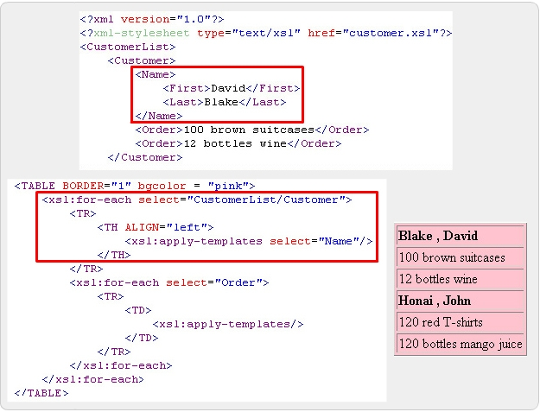
XSL Templates 2-2
The figure shows an example of XSL template.

Slide 29
Built-in Template Rules 1-3
The built-in template rules are as follows:
  Built-in template rule for modes: Ensures that elements and roots in any mode are processed. The built-in template rule for modes is as follows:
    <xsl:template match="*|/" mode="x">
    <xsl:apply-templates mode="x"/>
    </xsl:template>
  Built-in template rule for element and root nodes: Processes the root node and its children. The built-in template rules for element and root nodes are as follows:
    <xsl:template match="*|/">
    <xsl:apply-templates/>
    </xsl:template>

Slide 30
Built-in Template Rules 2-3
Built-in template rule for text and attribute nodes: Copies text and attribute nodes to the result tree. The built-in template rules for text and attribute nodes are as follows:
  <xsl:template match="text()|@*">
  <xsl:value-of select="."/>
  </xsl:template>
Built-in template rule for comment and processing instruction nodes: Does not perform any function. It is applied to the comments and processing instructions in the XML document. The built-in template rules for comment and processing instruction nodes are as follows:
  <xsl:template match="comment()|processing-instruction()"/>
Built-in template rule for namespaces node: Does not perform any function. It is applied to the namespaces node in the XML document. The built-in template rule for namespaces node is as follows:
  <xsl:template match="namespace()"/>

Slide 31
Built-in Template Rules 3-3
While traversing an XML document, template rules are activated in the order in which they match the elements. A template can change the order of traversal, and it can also prevent particular elements from being processed. The xsl:apply-templates element allows the user to choose the order in which the document is to be traversed.
For example, consider an element Order having child elements as OrderNumber, ItemInfo, and Price. The ItemInfo element has further child elements as ItemName and Quantity. The ItemName element comes before the Quantity element in the tree structure.
To get an output where Quantity is displayed before ItemName, the following template can be used:
  <xsl: template match= "ItemInfo">
  <xsl: value-of select= "Quantity"/>
  <xsl: value-of select= "ItemName"/>
  </xsl: template>

Slide 32
xsl:template Element 1-4
The xsl:template element is used to define a template that can be applied to a node to produce desired output.
The match attribute in xsl:template is used to associate the template with an XML element. You can also define a template for a whole branch of the XML document by using the match attribute (for example, match="/" defines the whole XML document).
Syntax
<xsl:template match="pattern" mode="mode" name="name" priority="number"> </xsl:template>
where,
  match: Is a pattern that is used to define which nodes will have which template rules applied to them. If this attribute is omitted there must be a name attribute.
  mode: Allows the same nodes to be processed more than once.
  name: Specifies a name for the template. If this attribute is omitted there must be a match attribute.
  priority: Is a real number that sets the priority of importance for a template. The higher the number, the higher the priority.

Slide 33
xsl:template Element 2-4
The syntax for the some of the match patterns are represented as follows:
  <xsl:template match ="/"> represents the root element in the XML document
  <xsl:template match = "name of the element"> represents all the elements in the XML document that have the specified name
  <xsl:template match = parent1/child> represents the child element by specifying the exact parent element
  <xsl:template match = "/ | *"> matches the entire document

Slide 34
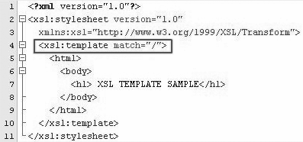
xsl:template Element 3-4
The code in figure demonstrates the usage of xsl:template element in style sheets.

Slide 35
xsl:template Element 4-4
Explanation for the figure:
  An XSL style sheet is an XML document itself, it always begins with the XML declaration: <?xml version="1.0" ?>.
  The next element, <xsl:stylesheet>, defines that this document is an XSLT style sheet document. It also contains the version number and XSLT namespace attributes.
  The <xsl:template> element defines a template. The match="/" attribute associates the template with the root of the XML source document.
  The content inside the <xsl:template> element defines some HTML to write to the output.
  The last two lines define the end of the template and the end of the style sheet.

Slide 36

xsl:apply-templates Element 1-4
The xsl:apply-templates element defines a set of nodes to be processed. This element, by default, selects all child nodes of the current node being processed, and finds a matching template rule to apply to each node in the set.
Figure shows the syntax for xsl:apply-templates.
where,
  select: Used to process nodes selected by an expression.
  mode: Allows the same nodes to be processed more than once. Each time the nodes are processed, they can be displayed in a different manner.

Slide 37
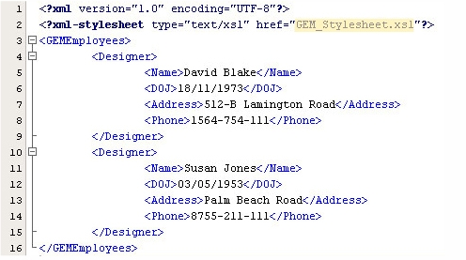
xsl:apply-templates Element 2-4
Figure shows an XML file.

Slide 38
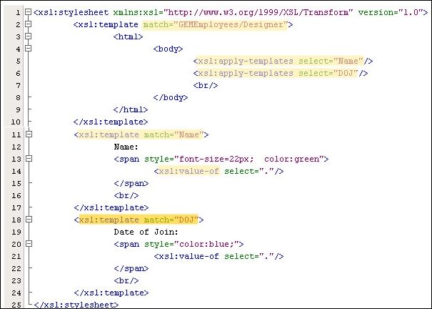
xsl:apply-templates Element 3-4
Figure depicts the GEM_Stylesheet.xsl file.

Slide 39
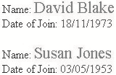
xsl:apply-templates Element 4-4
In the figure,
  match="GEMEmployees/Designer"
    Represents the Designer child element by specifying the GEMEmployees parent element.
  xsl:apply-templates select="Name"
    Applies the template on Name element.
  xsl:apply-templates select="DOJ“
    Applies the template on DOJ element.
  xsl:value-of
    Used to extract the value of a selected node.
  xsl:template match="Name"
    If the template is matched with Name element, the value of the Name element is displayed in green color with font size 22 pixels.
  xsl:template match="DOJ"
    If the template is matched with DOJ element, the value of the DOJ element is displayed in blue color.
Output:

Slide 40

The select Attribute 1-3
The select attribute can be used to process nodes selected by an expression instead of processing all children. The xsl:apply-templates with a select attribute can be used to choose a particular set of children instead of all children.
Figure shows the syntax for select attribute.
Explanation for the highlighted area in the image:
  select: Uses the same kind of patterns as the match attribute of the xsl:template element. If select attribute is not present, all child element, comment, text, and processing instruction nodes are selected.

Slide 41
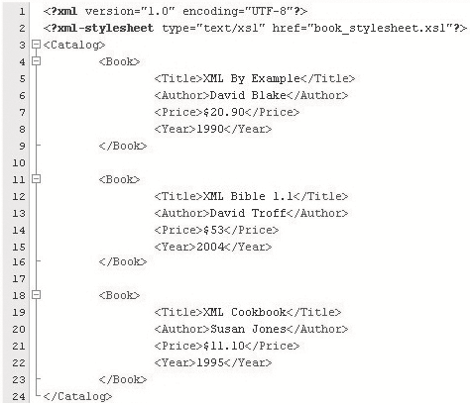
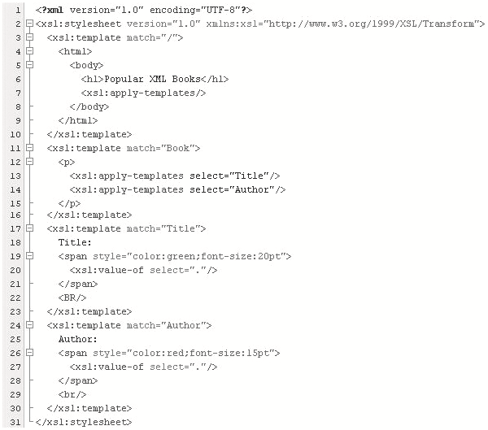
The select Attribute 2-3
Figure shows an XML file and the corresponding style sheet book_style sheet.xsl.

Slide 42
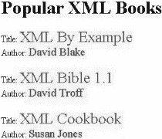
The select Attribute 3-3
In the style sheet,
  select="Title“: Applies the template on Title element.
  select="Author“: Applies the template on Author element.
The output is shown in figure.

Slide 43

xsl:value-of Element 1-3
The xsl:value-of element is used to write or display in the result tree a text string representing the value of the element specified by the select attribute. An xsl:value-of element can only have one node assigned to it.
Figure shows the syntax for xsl:value-of element.
where,
  select: A mandatory attribute that assigns the node (by name) to the element.
  disable-output-escaping: Specifies how special characters should appear in the output string.
  yes: Indicates that special characters should be displayed as is (for example, a < or >).
  no: Indicates that special characters should not be displayed as is (for example, a > is displayed as &gt;).

Slide 44
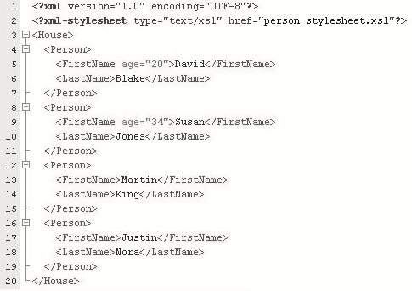
xsl:value-of Element 2-3
Figure shows an XML file.

Slide 45
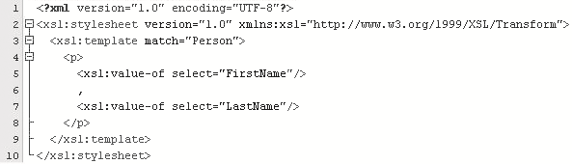

xsl:value-of Element 3-3
Figure depicts the style sheet for person_stylesheet.xsl file.
where,
  xsl:value-of select="FirstName“: Displays the
  value of the element FirstName.
  xsl:value-of select="LastName“: Display the value
  of the element LastName.
Output:

Slide 46

xsl:for-each Element 1-4
The xsl:for-each element can be used to iterate through the XML elements of a specified node set. It applies a template repeatedly to each node in a set.
Figure shows the syntax for xsl:for-each element.
Explanation for highlighted area in the image:
  select="expression“: The expression is evaluated on the current context to determine the set of nodes to iterate over.
  Figure shows the code for style rules that are defined in APTEmployees_stylesheet.xsl file.

Slide 47
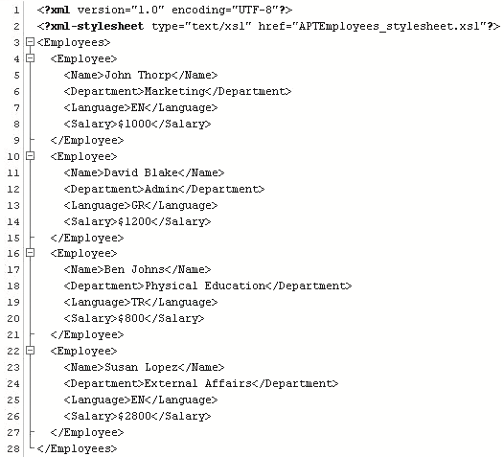
xsl:for-each Element 2-4
Figure shows an XML file.

Slide 48
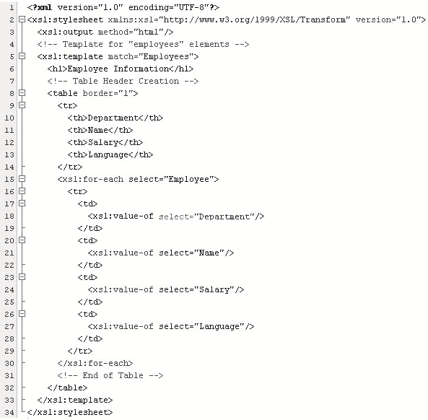
xsl:for-each Element 3-4
Figure depicts the style sheet for APTEmployees_stylesheet.xsl file.
where,
  xsl:for-each select="Employee“: Iterates through the Employee node and applies a template.
  xsl:value-of select="Department“: Displays the value of Department element.
  xsl:value-of select="Name“: Displays the value of Name element.
  xsl:value-of select="Salary“: Displays the value of Salary element.
  xsl:value-of select="Language“: Displays the value of Language element.
  </xsl:for-each>: End of for-each loop

Slide 49
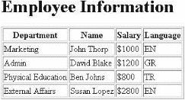
xsl:for-each Element 4-4
Output is shown in figure.

Slide 50

xsl:text Element 1-4
The xsl:text element is used to add literal text to the output. This element cannot contain any other XSL elements. It can contain only text.
Figure shows the syntax for xsl:text element.
Explanation for highlighted areas in the image:
  disable-output-escaping: Turns on or off the ability to escape special characters.
  yes: If the value is yes, a &gt; will appear as a >.
  no: If the value is no, a &gt; will appear as a &gt; in the text.

Slide 51
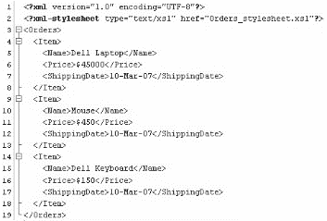
xsl:text Element 2-4
Figure shows an XML file.

Slide 52
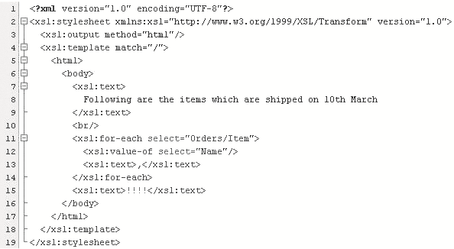
xsl:text Element 3-4
Figure depicts the style sheet for orders_stylesheet.xsl file.

Slide 53

xsl:text Element 4-4
In the figure,
  xsl:for-each select="Orders/Item“: Iterates through the Item element.
  xsl:value-of select="Name“: Displays the value of Name element.
  <xsl:text>,</xsl:text>: Inserts a comma (,) after each name value.
  <xsl:text>!!!!</xsl:text>: Inserts four exclamation marks (!) at the end of the output.
The output is shown in figure.

Slide 54
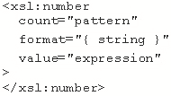
xsl:number Element 1-3
The xsl:number element can be used to determine the sequence number for the current node. It can also be used to format a number for display in the output.
Figure shows the syntax for xsl:number element.
where,
  count="pattern"
  Indicates what nodes are to be counted. Only nodes that match the pattern are counted.
  format="{ string }"
  Sequence of tokens that specifies the format to be used for each number in the list.
  value="expression"
  Specifies the expression to be converted to a number and output to the result tree.

Slide 55
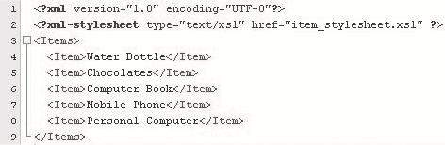
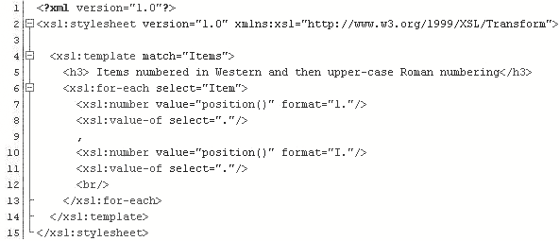
xsl:number Element 2-3
Figure shows an XML file.
Figure depicts the style sheet for item_stylesheet.xsl file.
where,
  position(): The current node's position in the source document.
  format="1.“: User-provided number starts with 1.
  format="I.“: User-provided roman number starts with I.

Slide 56
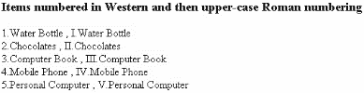
xsl:number Element 3-3
The output is shown in figure.
where,
  1.Water Bottle, I.Water Bottle: The first item is numbered with number 1 and roman number I.
  4.Mobile Phone, IV. Mobile Phone: The fourth item is numbered with number 4 and roman number IV.

Slide 57

xsl:if Element 1-3
The xsl:if element evaluates a conditional expression against the content of the XML file. The test attribute of xsl:if element contains a conditional expression that evaluates to a boolean value of true or false.
Figure shows the syntax for xsl:if element.
where,
  test=expression: The condition in the source data to test with either a true or false answer.

Slide 58
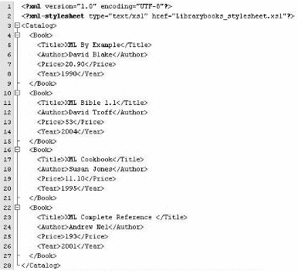
xsl:if Element 2-3
Figure shows an XML file.

Slide 59
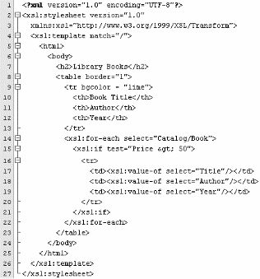
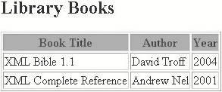
xsl:if Element 3-3
Figure depicts the style sheet for librarybooks_stylesheet.xsl file.
where,
  <xsl:for-each select="Catalog/Book">: Iterates through the Book node.
  <xsl:if test="Price &gt; 50">: Checks if the price of the book is greater than 50. If true, Author, Title and Year are displayed.
Output:

Slide 60
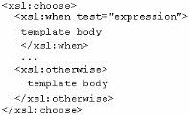
xsl:choose Element 1-3
The xsl:choose element is used to make a decision when there are two or more possible courses of action.
The xsl:choose element is used in conjunction with xsl:when and xsl:otherwise to express multiple conditional tests.
Figure shows the syntax for xsl:choose element.
where,
  xsl:when test="expression“: The xsl:when element is examined in the order of occurrence. If the test expression is true, the code contained in that element is executed.
  xsl:otherwise: If all the test conditions in any xsl:when elements are false, then the xsl:otherwise element is automatically selected and the code associated with that element is executed.

Slide 61
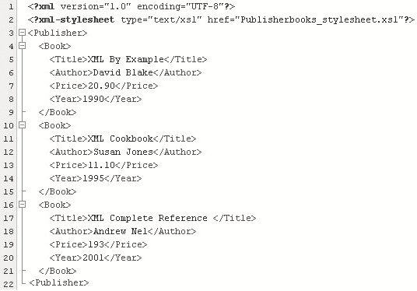
xsl:choose Element 2-3
Figure shows an XML file.

Slide 62
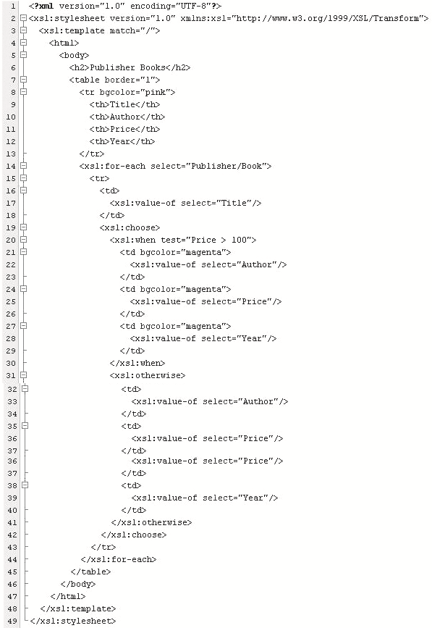
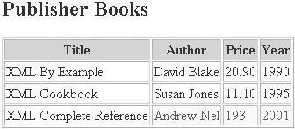
xsl:choose Element 3-3
Figure depicts the style sheet for publisherbooks_stylesheet.xsl file.
where,
  xsl:when test="Price > 100“: Checks whether the price of the book is greater than 100. If true, the details such as Author, Price, and Year are displayed with magenta as the background color.
  xsl:otherwise: If all the conditions are false, this block is executed. Here, all other book details are printed in normal background color.
Output:

Slide 63

Sorting in XSLT 1-4
The xsl:sort element in XSLT can be used to sort a group of similar elements. The sorting can be done in various ways by using the attributes of this element.

Slide 64

Sorting in XSLT 2-4
Figure shows the syntax for xsl:sort element.
Explanation for highlighted areas in the image:
  case-order: Indicates whether the sort will have upper or lowercase letters listed first in the sort output. The default option is to list uppercase first.
  data-type: Specifies the data type of the strings.
  number: Sort key is converted to a number.
  qname: Sort is based upon a user-defined data type.
  text: Specifies that the sort keys should be sorted alphabetically.
  order: The sort order for the strings. The default value is ‘ascending’.
  select:Expression that defines the key upon which the sort will be based. The expression is evaluated and converted to a string that is used as the sort key.

Slide 65
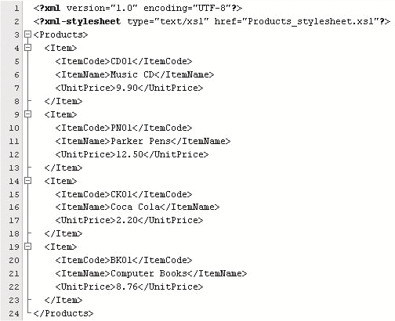
Sorting in XSLT 3-4
Figure shows an XML code.

Slide 66
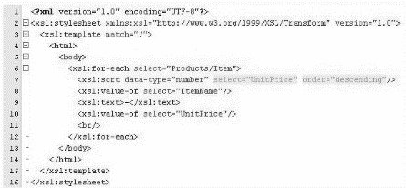

Sorting in XSLT 4-4
Figure depicts the style sheet for products_stylesheet.xsl file.
Explanation for highlighted areas in the style sheet:
  select="UnitPrice" : Sort is based on UnitPrice element.
  order="descending“: The sorting order for UnitPrice is descending in that the higher value will be displayed first.
Output:

Slide 67
Summary
In this module, XSL and XSLT, you learnt about:
  Introduction to XSL
    XML provides the ability to format document content. XSL provides the ability to define how the formatted XML content is presented. An XSL Transformation applies rules to a source tree read from an XML document to transform it into an output tree written out as an XML document.
  Working with XSL
    An XSL template rule is represented as an xsl:template element. You can process multiple elements in two ways: using the xsl:apply-templates element and the xsl:for-each element. The xsl:stylesheet element allows you to include a style sheet directly in the document it applies to. The xsl:if element produces output if, and only if, its test attribute is true.

